Slide 1



CMPG 315
Packet Tracer
Network Design
By: Group 12

Slide 2
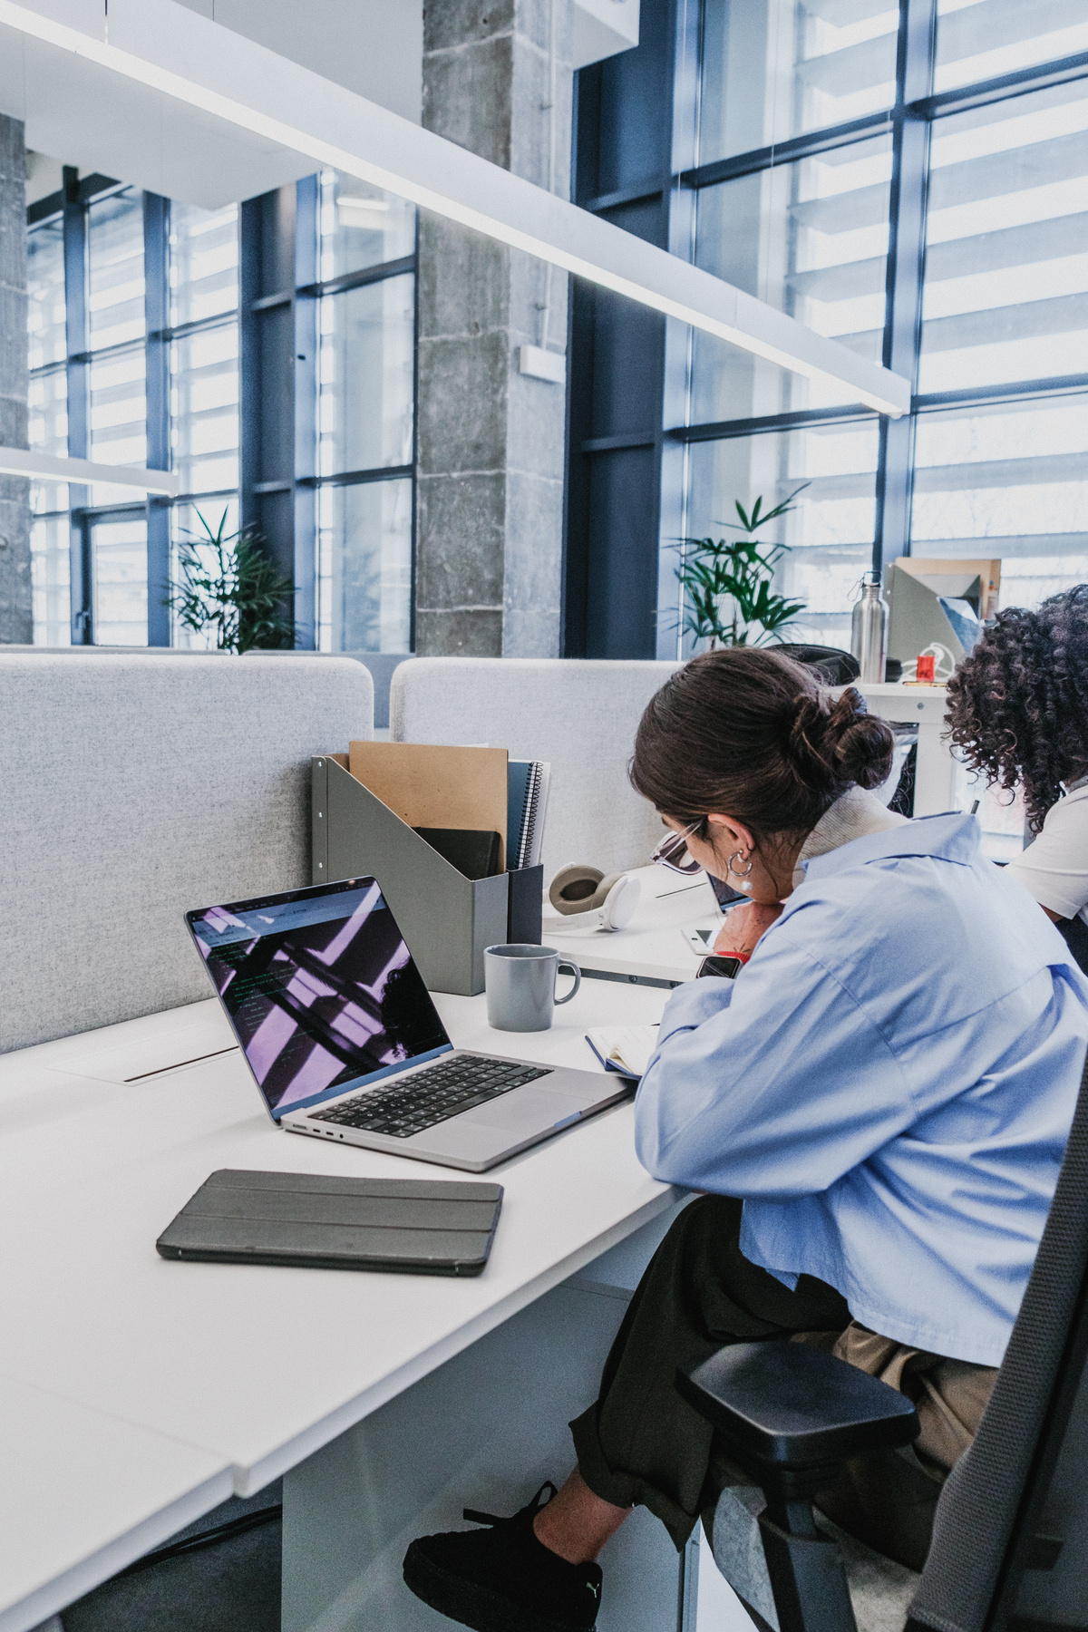

Overview
Introduction
01
Company Overview
02
Network Requirements
03
Physical Design Overview
04-06
Budget Overview
07-08
Remote Access Solutions
09
Our Team
10

Slide 3

Introduction
This project involves designing a functional and secure network for a legal tech company using Cisco Packet Tracer. The goal was to create a realistic office network setup that includes multiple departments, wired and wireless devices, internet connectivity, and proper IP addressing. Due to budget constraints, routers are used to manage both connectivity and network security through Access Control Lists (ACLs). The design ensures efficient communication, controlled access, and scalability while reflecting a real-world office environment.

Slide 4




Company Overview
We based our network design on the following shared assumptions to ensure consistency
Employees : Approximately 180
Devices : Approximately 880
Wired : 170
Wireless : Approximately 700
Departments :
Admin, HR, IT, Kitchen, Reception, Boardroom
Office Layout :
Open-plan setup for collaboration
Dedicated spaces for key functions

Slide 5

Network Requirements
Here we highlight the key network requirements based on the company's setup and goals, ensuring the design supports efficiency, security, and scalability
Requirements include:
High-speed internet connectivity for all users
Secure access control (wired priority)
Wireless access for mobile and guest devices
Scalability for future expansion
Support for printing and conferencing

Slide 6
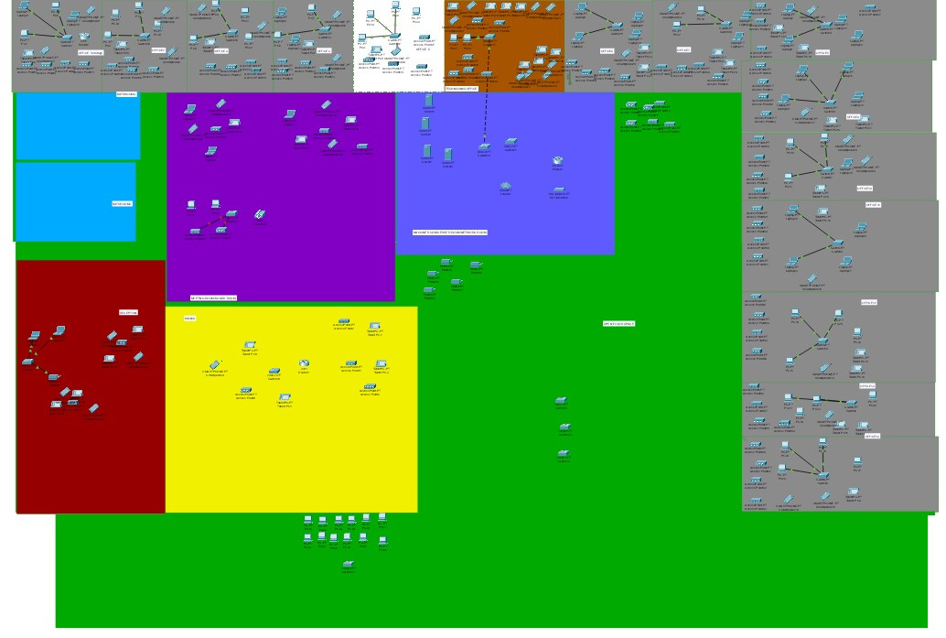
Physical Design Overview
Presentation of a high-level view of the physical layout used in our design :
Open-plan layout with designated areas (reception, kitchen, boardroom).
Core devices: routers, switches, access points, printers.
UTP cabling for wired connectivity.
Centralized internet gateway with DHCP & DNS configured.

Slide 7
Physical Design Overview
Offices
Technician’s Office
Meeting/Board Room
Machine/Server Room
Bathrooms
Reception
Kitchen
Open Floor

Slide 8
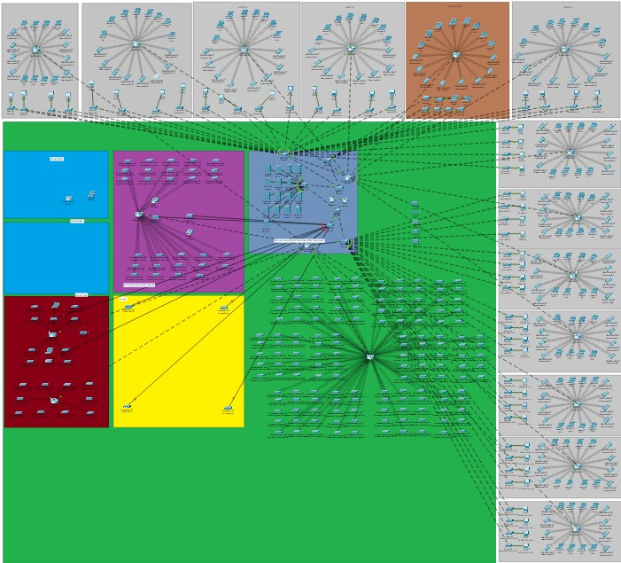
Physical Design Overview
Here we highlight how devices are physically deployed to support network performance:
10 Netgear switches and 5 Cat6 cable rolls support the wired setup.
30 Ubiquiti APs ensure full wireless coverage.
6 printers and 1 Logitech video system placed for accessibility.
Supports 180 staff, ~170 wired and ~700 wireless devices.
Devices are positioned in open offices, kitchen, reception, and boardroom.

Slide 9
Budget Overview
Hardware Costs
Labour Costs
R34k
R75k
R6.5k
R16.25k
Netgear Switches
Ubiquiti APs
Network Design and Planning
Hardware Installation
R3.135k
R33.594k
R22.75k
R9.75k
Cat6 Cables
HP Printers
Cabling and Infrastructure Setup
Testing and Troubleshooting
R96.999k
R242.728k
R4.55k
R59.8k
Logitech System
Subtotal
Documentation and Handover
Total Labour Costs

Slide 10


Budget Overview
Contingency
Grand Total
R
24.272k
R
326.8k

Slide 11
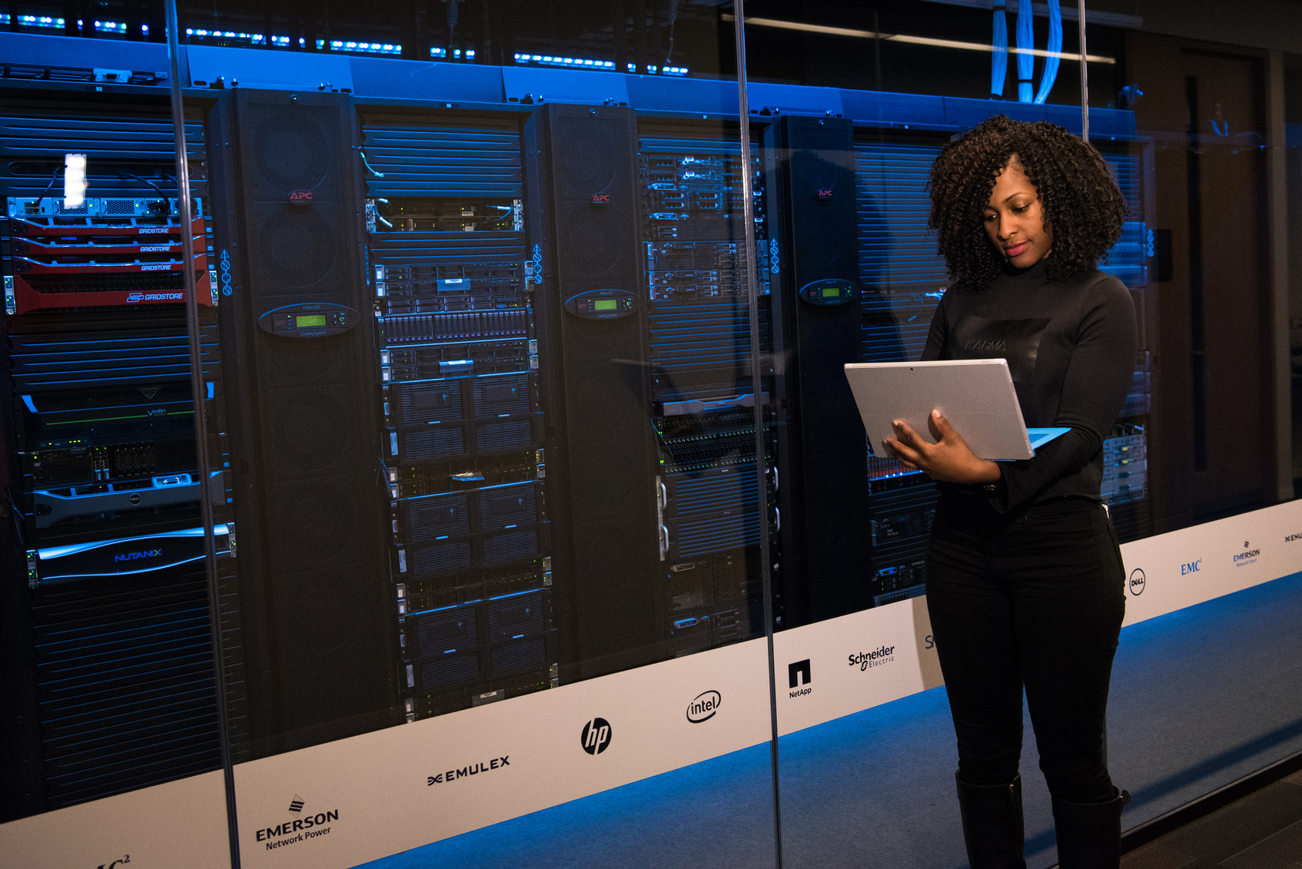


Remote Access Solutions
Here we explain how secure remote access is ensured in the network, despite budget limitations.
Remote Access Configuration:
Security Focus:
Budget Consideration:
Implemented via router-based Access Control Lists (ACLs).
Only authorized users have remote access privileges
Internal IP ranges protected from external intrusion.
Only necessary ports opened for remote work .
No additional firewall devices due to cost.
Security enforced using already available routers.

Slide 12
Our Team
Tamandani Stima
42956706
Kainga Malinga
Sinovuyo Sondara
Panashe K Tarusenga
46583092
41434366
45204756
Nhlanhla Nwariwe
Siyabonga Mnguni
Orinea Mulaudzi
43511139
40987167
47639717

Slide 13


CMPG 315
THANK YOU!

